Slide 1

Jira Tool

Slide 2
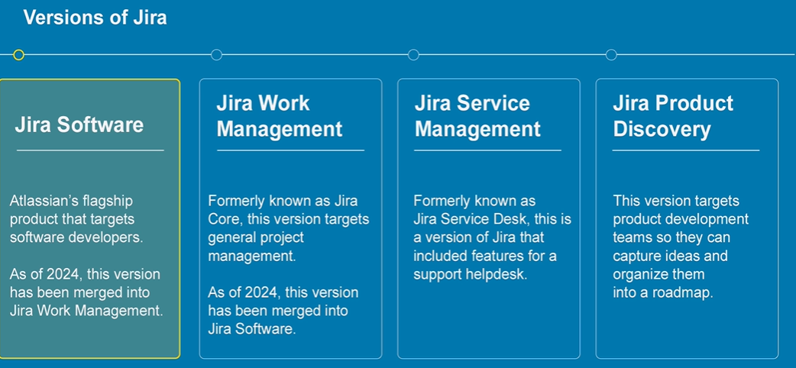
Introduction:
project management and issue tracking platform developed by Atlassian.
Jira uses Agile Methodology to manage the project.
Jira has different versions

Slide 3
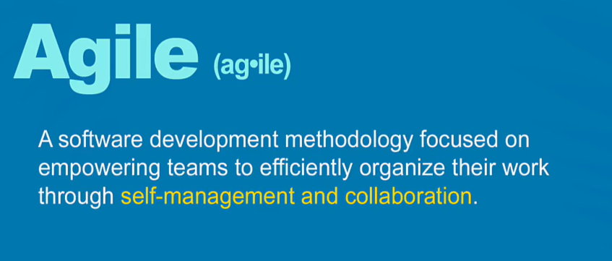
What is Agile:

Slide 4

Agile Board: To track the progress
1. To do
2. In Progress
3. Done
Two types of agile board

Slide 5
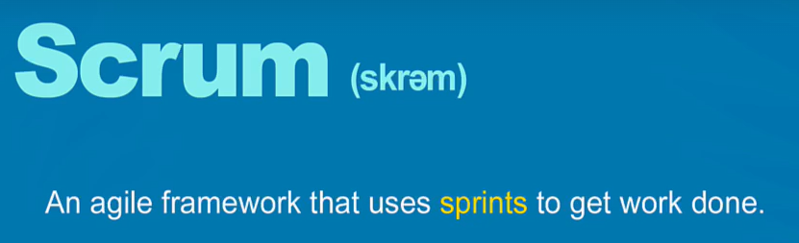
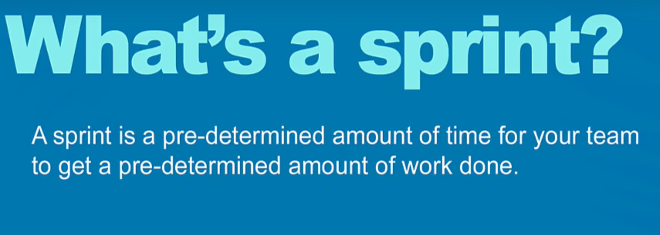

Slide 6
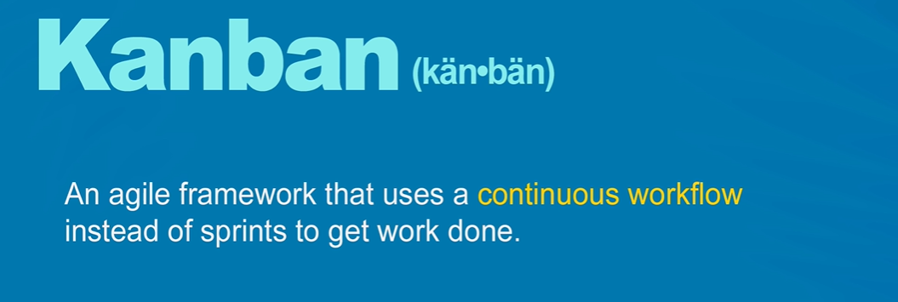
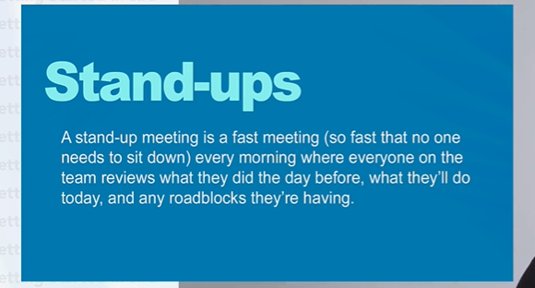

Slide 7
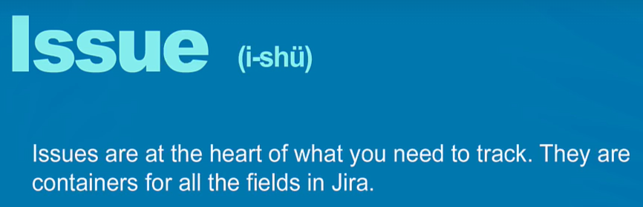
1. Epic 2. Story 3. Task 4. Bug 5. User can create customized issue type

Slide 8
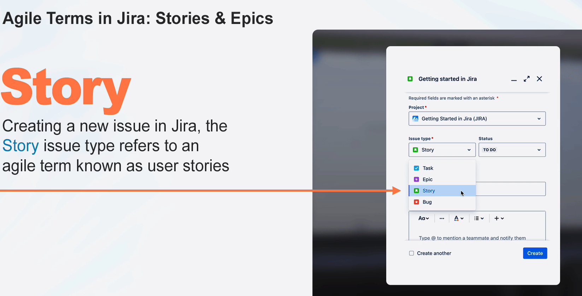
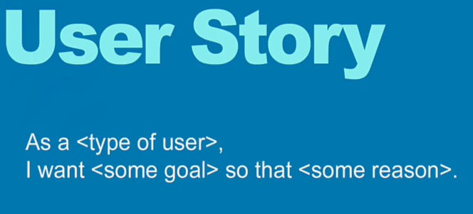

Slide 9
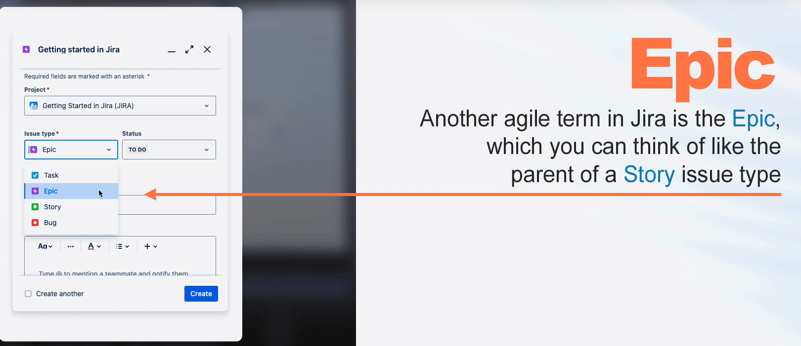
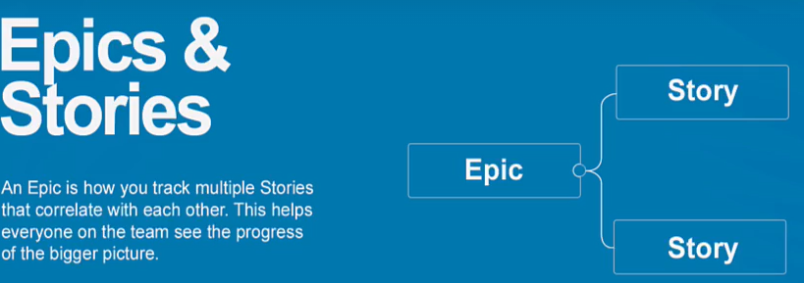
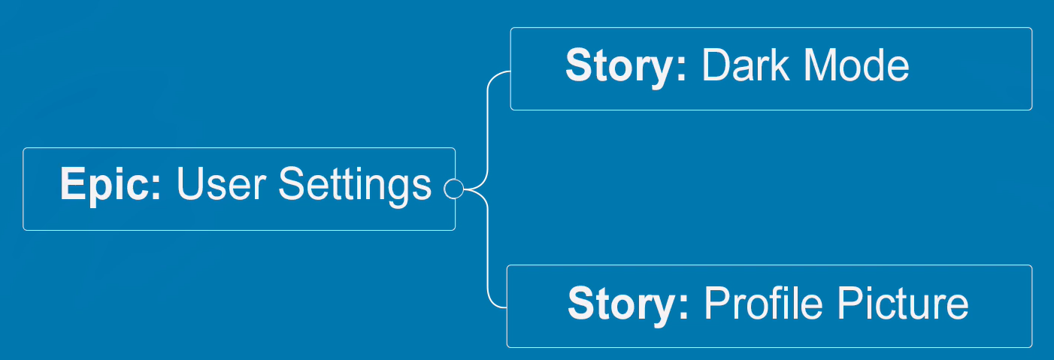

Slide 10
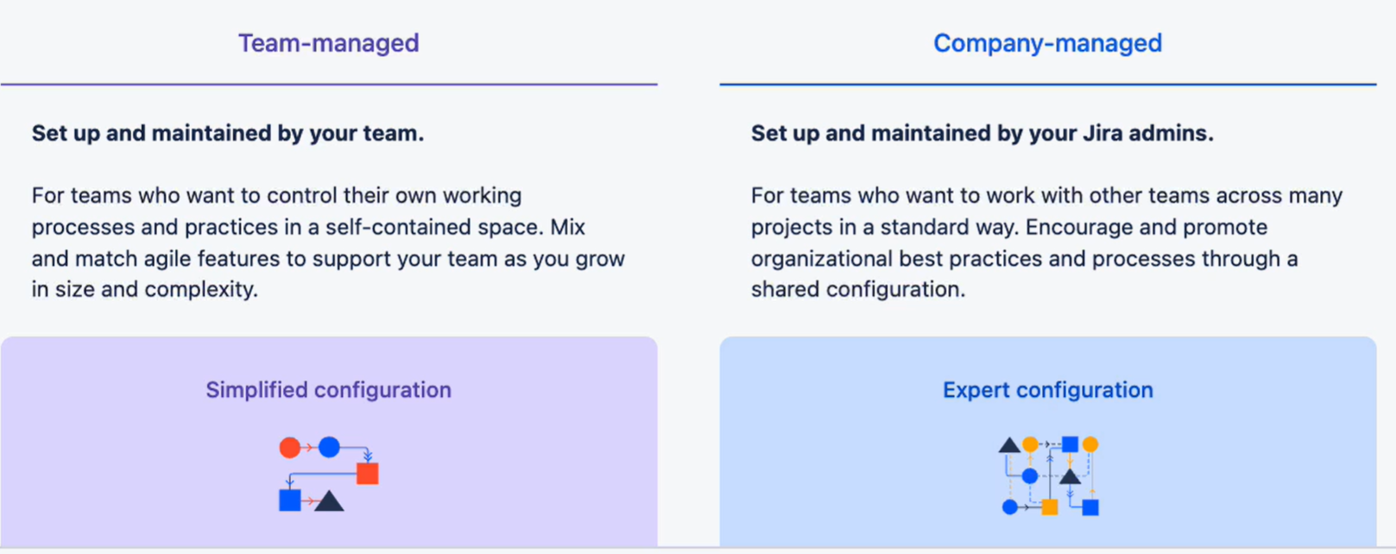
Types of Project in Jira

Slide 11
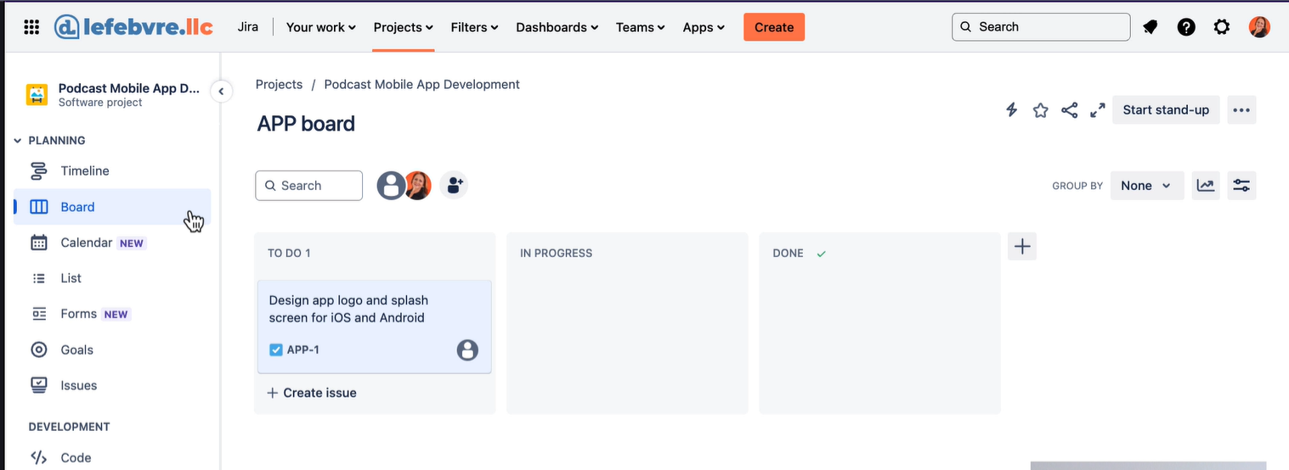
Kanban Board of Team Managed Project: Kanban Board

Slide 12
Types of Role in Jira
1. Member
2. Administrator
3. Customized Role

Slide 13
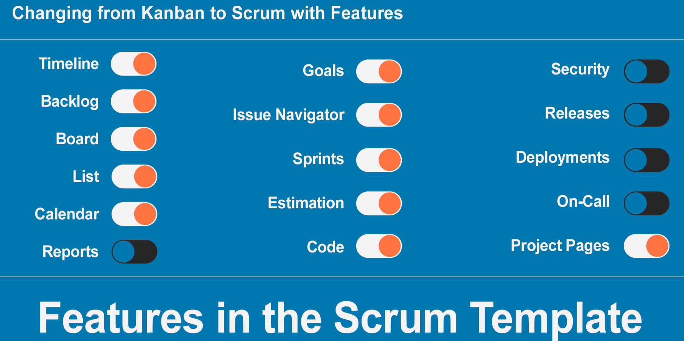
Features in Scrum Template

Slide 14
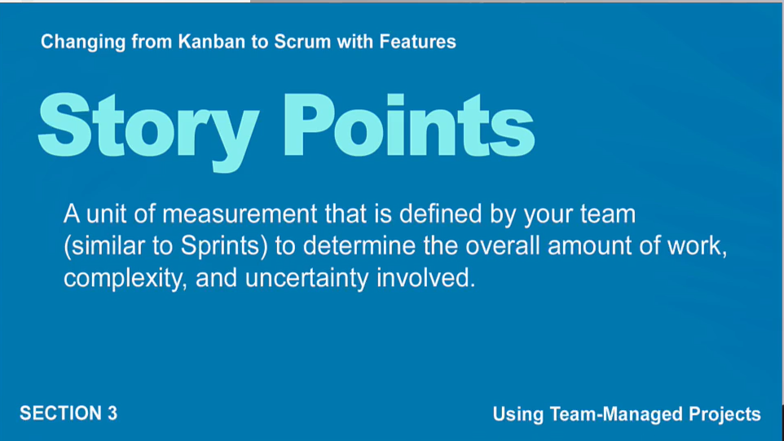
Story Points

Slide 15
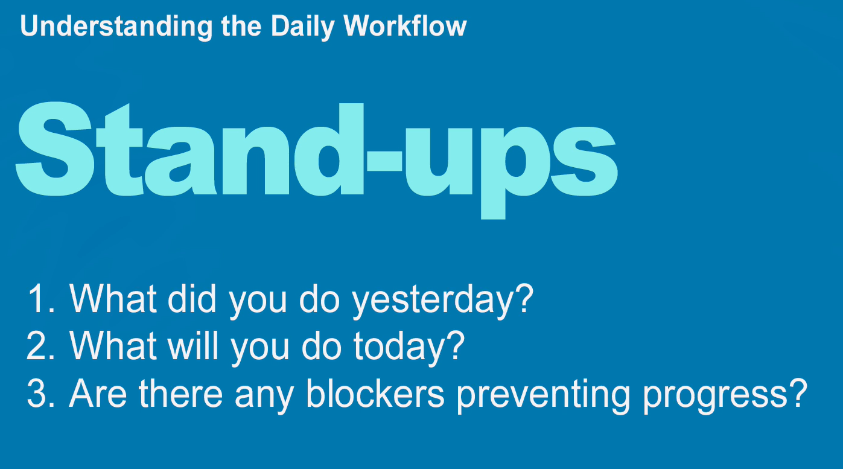
Daily Workflow

